Slide 1
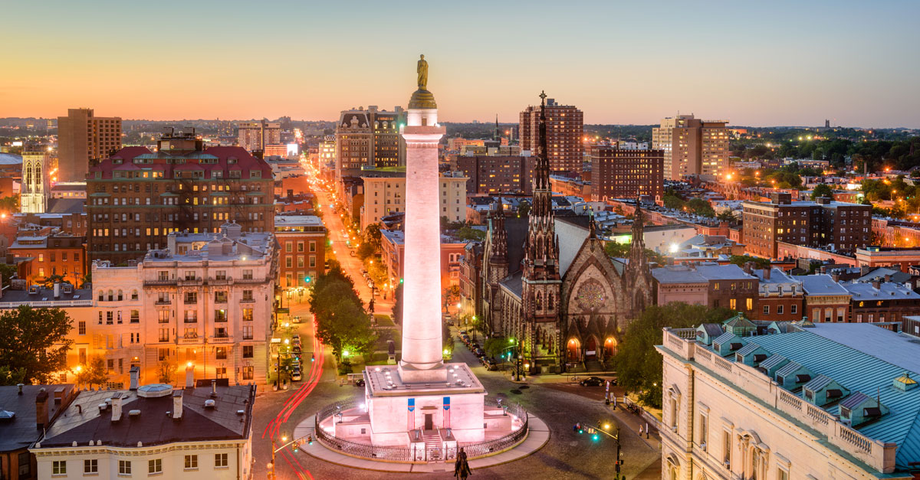
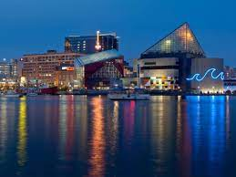
SPONSOR & EXHIBITOR
OPPORTUNITIES
September 25-26, 2024
The Royal Sonesta Harbour Court
Baltimore, Maryland www.fitng.org

Slide 2
It is our pleasure to invite you to support our 2024 FIT’NG Conference.
The FIT’NG community of researchers specializes in neuroimaging pre-birth and during the first two years of postnatal life. Human brain development is a complex process. Advancing understanding of early neurodevelopmental processes, and the conditions which foster healthy versus malsecondadaptive development, represents a critical means of addressing these challenges.
As a new society our membership is only growing. Based on past events, we expect 250 attendees from around the globe to join the FIT’NG Conference. This provides you with an excellent opportunity to showcase your organization, products and services and interact with people around the globe.
ADVERTISE in our digital program, be an EXHIBITOR and display your products virtually, or SPONSOR a portion of the conference, monthly workshops/seminars, and/or the society itself.

Slide 3
About FIT’NG
The Fetal, Infant, Toddler Neuroimaging Group (FIT’NG) was founded in the Fall of 2018 by Drs. Marisa Spann (CUIMC), Dustin Scheinost (Yale), Alice Graham (OHSU), and Lilla Zöllei (MGH/HMS). It is composed of interdisciplinary scientists who have an interest in elucidating early developmental contributions of the brain to behavioral outcomes and the influence of prenatal and postnatal adversities.
The network provides a forum for early childhood neuroimaging scientists, including EEG, fNIRS, MRI, MEG, OCT, histology, DOT, ultrasound, and other modalities that supports this goal through advancements in scan procedures (to enhance data quality), data processing and analyses procedures, and direct application through neuroscience discoveries. A primary objective is to take the lead in establishing guidelines for best practices within this new and evolving field. FIT’NG provides a forum across three core areas: methodological development, education/training advancement, and data sharing and integration.

Slide 4
The FIT’NG Society is pleased to deliver the next FIT’NG Conference at The Royal Sonesta Harbour Court Hotel in Baltimore, Maryland from September 25-26th, 2024. This meeting will continue to help build a community for networking, training, and collaborative endeavors, as well as a platform for software and hardware developers and users of the tools to engage in constructive discussions related to technological and methodological gaps in researcher knowledge. We are aiming to create a gathering place for networking, sharing of knowledge, and creating shared experiences.
2024 Conference

Slide 5
Who attends?
multi-disciplinary group of scientists and academics in the fields of neuroscience, neurodevelopment, image acquisition and image post-processing focused on the perinatal and early childhood periods. Numerous technological advances allow for many ways to study different aspects of brain development. A primary objective spanning these areas is to encourage the establishment and dissemination of guidelines to support best practices for methods used to study the developing brain, including EEG, fNIRS, MRI, MEG, OCT, histology, DOT, ultrasound, and others.
individuals from the tool development side of imaging (‘developers’, i.e., engineers, data scientists, physicists, and computer scientists) and those conducting with young children (‘appliers’, i.e., psychologists, neuroscientists, psychiatrists).

Slide 6
Connect with leading and emerging researchers
Approximately 200 scientists and allied professionals from around the world are anticipated to attend this conference
Why
Sponsor?
Premium branding & positioning
As a conference sponsor, your brand will reach all FIT’NG members and allied professionals via email blasts to the database
Introduction to leading professionals
Sponsorship options allow you an opportunity to increase your company’s recognition, introduce your new products to the community, and differentiate your company from your competitors

Slide 7
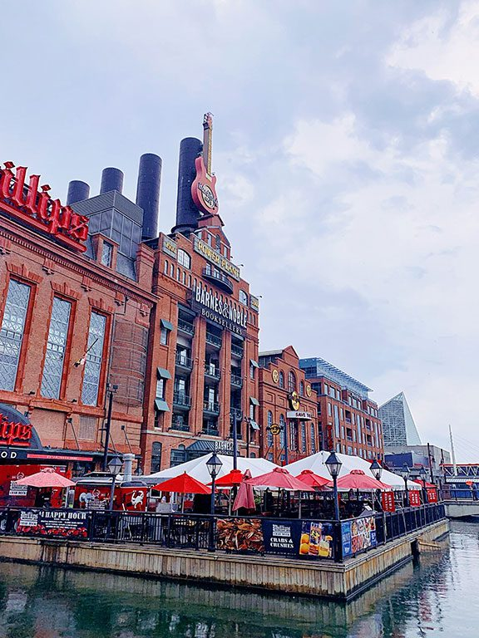
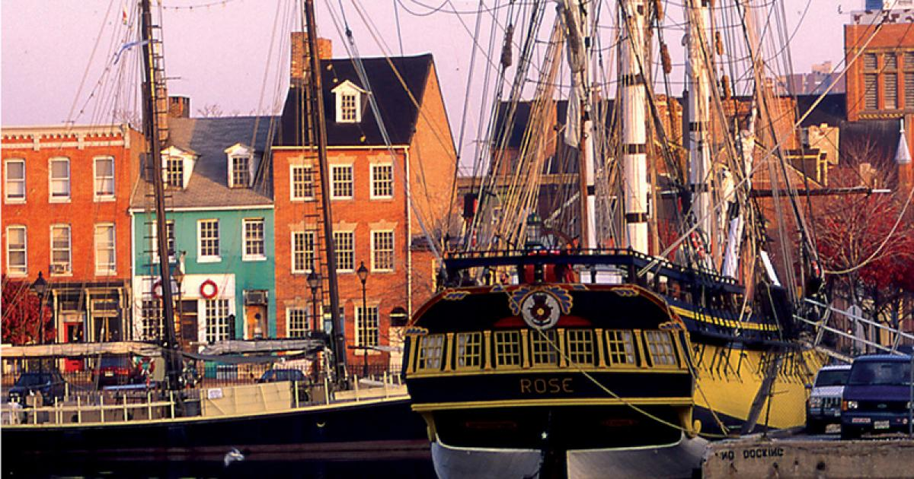
Sponsorship Levels & Benefits

Slide 8
Sponsor Levels
Let us build the sponsorship package that best matches your budget and fulfills your objectives
Level | Platinum $10,000 | Gold $5,000 | Silver $2,500 | Bronze $1,500
Named Sponsor for the Conference Hall and Social Events | √
Exclusive presentation in Sponsor Spotlight Session in main room | √
Sponsor of one of the main Panel Sessions (5 opportunities) | √ | √
Choose to Sponsor one of the Coffee Breaks or Poster Sessions | √ | √ | √
Logo onsite, conference communications and program | √ | √ | √ | √
Complimentary Table-Top Exhibit registration | Preferred exhibit location plus 2 Reps | Secondary preferred location plus 2 Reps | 1 Rep | 1 Rep

Slide 9
Additional Sponsorship Opportunities
FIT’NG Together Webinar Sponsor Monthly opportunity to get recognition outside of the conference Topical workshops, e.g., EEG or fNIRS workshop | $2,000
6ft Table-Top Exhibit To be hosted during the poster sessions daily | $1000
Ad in the Digital Conference Program ½ page Ad, colour, must be submitted prior to July 31, 2024 Advertisement on website Opportunity for partnership on webinars | $500

Slide 10
HOW TO BECOME A SPONSOR
Should you wish to discuss sponsor opportunities with FIT’NG, please contact:
Tori Lunden
FIT’NG Secretariate
Podium Conference and Event Specialists
Email: Tori@podiumconferences.com

